Slide 1

Big Mart Sales Prediction
by
E. Sai Naga Mounika
Roll No. 184G1A0575
Y. Siva Kalyani
Roll No. 184G1A0590
M. Sai Tejaswini
Roll No. 184G1A0580
Under the guidance of
Mrs. M. Soumya _{M.Tech.,(Ph.D)}
Assistant Professor
Department of Computer Science and Engineering
Srinivasa Ramanujan Institute of Technology
(Affiliated to JNTUA & Approved by AICTE) (Accredited by NAAC with ‘A’ Grade & Accredited by NBA (EEE, ECE & CSE))
Rotarypuram Village, B K Samudram Mandal, Ananthapuramu – 515701.
2021 - 2022

Slide 2
Abstract
The basic premise of machine learning is to build model and employee algorithms that can receive input data and use statistical analysis to predict an output while updating outputs as new data becomes available. These models can be applied in different areas and trained to match the expectations of management so that accurate steps can be taken to achieve the organization’s target.
In this project,the case of Big Mart, a one-stop-shopping center’s data is used to predict the sales of different types of items and for understanding the effects of different factors on the item’s sales .Here, we propose a predictive models like Linear, Ridge, Random Forest, XG Boost regression models for predicting the future sales of a company like Big Mart and found that the models produces better performance.A comparitive analysis of the model with others in terms of performance metrics is performed.

Slide 3

Contents
Introduction
Literature Survey
Existing System
Proposed System
Problem Definition
Requirements
UML Diagram
Data Flow Diagram
Implementation
Sample code
Execution & Results
Conclusion
References

Slide 4
Introduction
With the rapid development of global malls and store chains and the increase in the number of electronic payment customers, the competition among the organizations is becoming serious day by day.
Each organization is trying to attract more customers using short-time offers which makes the prediction of future volume of sales of every item.
For forecasting the future sales, we are taking the sales data of Big Mart across different locations and stores.
According to the characteristics of the data, we can use the regression models for forecasting future sales volume.

Slide 5
Literature Survey
[1](Gopal Behara,Neeta Nain-1)
In today’s world Big Malls and Marts record sales data of individual items for predicting future demand and inventory management.In this paper, the authors collected sales data for the year 2013 across 10 stores in different cities.This data stores a large number of attributes of the item as well as individual customer data together in a data warehouse.This data is mined for detecting frequent patterns as well as anamolies.Here, the authors proposed the methodology for predicting the future sales by using Regression models.And those models are compared with the Xgboost Regression model. These algorithms will be trained by using the sales data.And by using the test data,the models are tested.
[2](Aaditi Narkhede,Mitali Awari,Suvarana Gawali,Amarpal-2)
In this paper,the authors proposed machine learning techniques which are used to predict the future sales.Those are Linear regression,Ridge regression,Decision tree,Random forest ,XgBoost models.Among these models,Xgboost regression model is having low RMSE value i.e,High accuracy.

Slide 6
Existing System
Now-a-days shopping malls and Big Marts keep the track of their sales data of each and every individual item for predicting future demand of the customer and update the inventory management as well.
These data stores basically contain a large number of customer data and individual item attributes in a data warehouse.
In the Existing system, we used Traditional methods(Statistical methods) like survey method, collective opinion method etc., but these methods could not work better for non-linear data and when the data is huge.

Slide 7
Proposed System
Here, we are proposed machine learning models to find which item has more sales in a particular region.
Those predictive models are Linear, Ridge, Random Forest, XG Boost Regression for predicting the sales of a company like Big Mart for the accurate results.
And also we create an user interface page where user can fill the values of the attributes of the dataset.And by clicking the “Predict” button it gives the value which is the future scope of a particular product in the means of highest value.

Slide 8
Problem Definition
Forecasting of sales plays an vital role in any shopping complex.
Here,we are addressing the problem of sales prediction or forecasting of an item based on customer’s future demand in different big mart stores across various locations and products based on the previous record.
To find out the what properties of an particular product and stores will make more sales and increasing their revenue.

Slide 9
Requirements
Software Requirements:
Operating System : Windows 10.
Language : Python 3.6.
Platform : Jupyter Notebook, Pycharm
Libraries : Numpy, Matplotlib, Pandas, Sklearn.
Hardware Requirements:
Processor : i3/i5 processor.
Hard Disk : 40GB.
RAM : 4GB/8GB.

Slide 10
UML Diagram
Activity Diagram:
Collecting the data
Data Preprocessing
Data Analysis
Train –Test Split
Training the models
Testing the models
Evaluating the results

Slide 11
Data Flow Diagram
Data Flow Diagram:
Collecting the Dataset
Data Exploration
Data Cleaning
Model Testing
Model Building
Feature
Engineering
Result

Slide 12
Implementation
Collecting the dataset:
By using Big Mart sales data we are implementing our project.
Data Preprocessing:
The data has missing values as some stores do not report all the data due to technical glitches. Hence, it will be required to treat them accordingly.
Feature Engineering:
For the conversion of categorical values to numerical values.
Building the Models
Testing the Models
Integrating the model and front end in order to develop the user interface.

Slide 13
…Contd
Here, we are using the programming language called Python, which is a general purpose, interpreted-high level language used extensively for solving domain problems.
Python has various libraries used for scientific purposes and for making problem solving efficient.
Those are:
Numpy
Pandas
Matplotlib
Sklearn

Slide 14
Sample Code
Here is the sample code about how we split the features and target.And we split the 80%of the dataset for training and 20% of the dataset for testing.
X=data.drop(columns=‘Item_Outlet_Sales’,axis=1)
Y=data[‘Item_Outlet_Sales’]
X_train,X_test,Y_train,Y_test=
train_test_split(X,Y,test_size=0.2,random_state=2)
print(X.shape,X_train.shape,X_test.shape)
The above code for splitting the data for training and testing.

Slide 15
…Contd
Sample code for Linear Regression:
from sklearn.linear_model import LinearRegression
#Training the Simple Linear Regression model on the Training set
model = LinearRegression(normalize=True)
#Predicting the Test set results
Model.fit(X_train,Y_train)
y_pred = model.predict(X_train)
from sklearn.metrics import r2_score,mean_squared_error
score = r2_score(y,y_pred)
print("ScoreofTraining:",100*score)
print("RMSE:%.4g"%np.sqrt(mean_squared_error(Y_train,y_pred)))

Slide 16
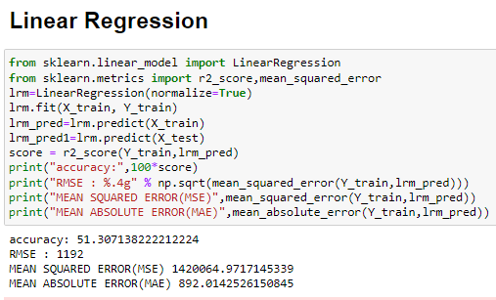
…Contd
Accuracy of Linear Regression is: 51.30%

Slide 17
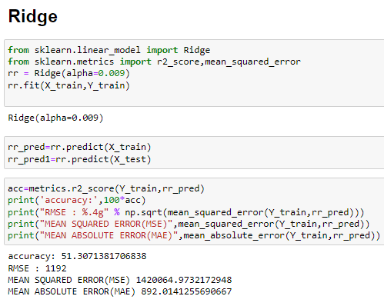
…Contd
Sample code for Ridge Regression:
from sklearn.linear_model import Ridge
rr = Ridge(alpha = 0.009)
rr.fit(x_train, y_train)
#Prediction AFTER Ridge regression
rr_pred = rr.predict(x_train)
#Accuracy score check
r2_score_RR=r2_score(y_train,y_pred)
print('R2_Score:',r2_score_RR*100,"%" )
Accuracy of Ridge regression model is: 51.307%

Slide 18
…Contd
Sample code for Random Forest:
from sklearn.ensemble import RandomForestRegressor
rf = RandomForestRegressor()
rf.fit(X_train,Y_train)
y_pred =rf.predict(X_train)
From sklearn.metrics import r2_score,mean_squared_error
score = r2_score(Y_train,y_pred)
print("Score:",100*score)
print("RMSE : %.4g" % np.sqrt(mean_squared_error(Y_train,y_pred)))

Slide 19
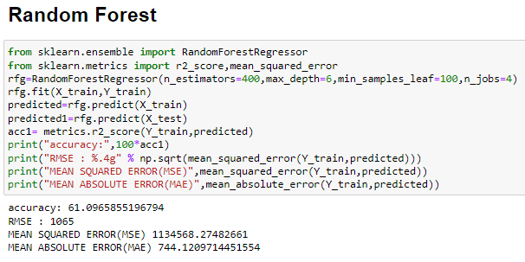
…Contd
Accuracy of Random Forest is: 61.09%

Slide 20
…Contd
Sample code for XG Boost Regression model:
from xgboost import XGBRegressor
model = XGBRegressor()
Model.fit(X_train,Y_train)
y_pred=model.Predict(X_train)
from sklearn.metrics import r2_score,mean_squared_error
score = r2_score(Y_train,y_pred)
print("Score of Training:",100*score)
print("RMSE : %.4g" % np.sqrt(mean_squared_error(Y_train,y_pred)))

Slide 21
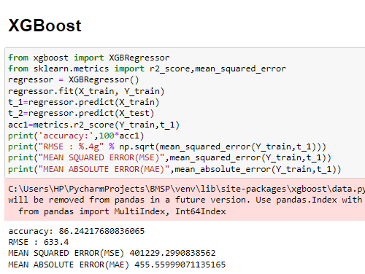
…Contd
Accuracy of XG Boost Regression is: 86.24%

Slide 22
Execution & Results
Here, we are using flask web framework in order to develop the user interface to provide the values of the input attributes and to predict the value of the target attribute.
We developed this web page by using Pycharm platform because of its flexibility of using python language.
Whenever, we run the python file(app.py) it gives the link which redirects the page to user interface where we can fill the values of the attributes.
Here is the link:
http://127.0.0.1:5000

Slide 23
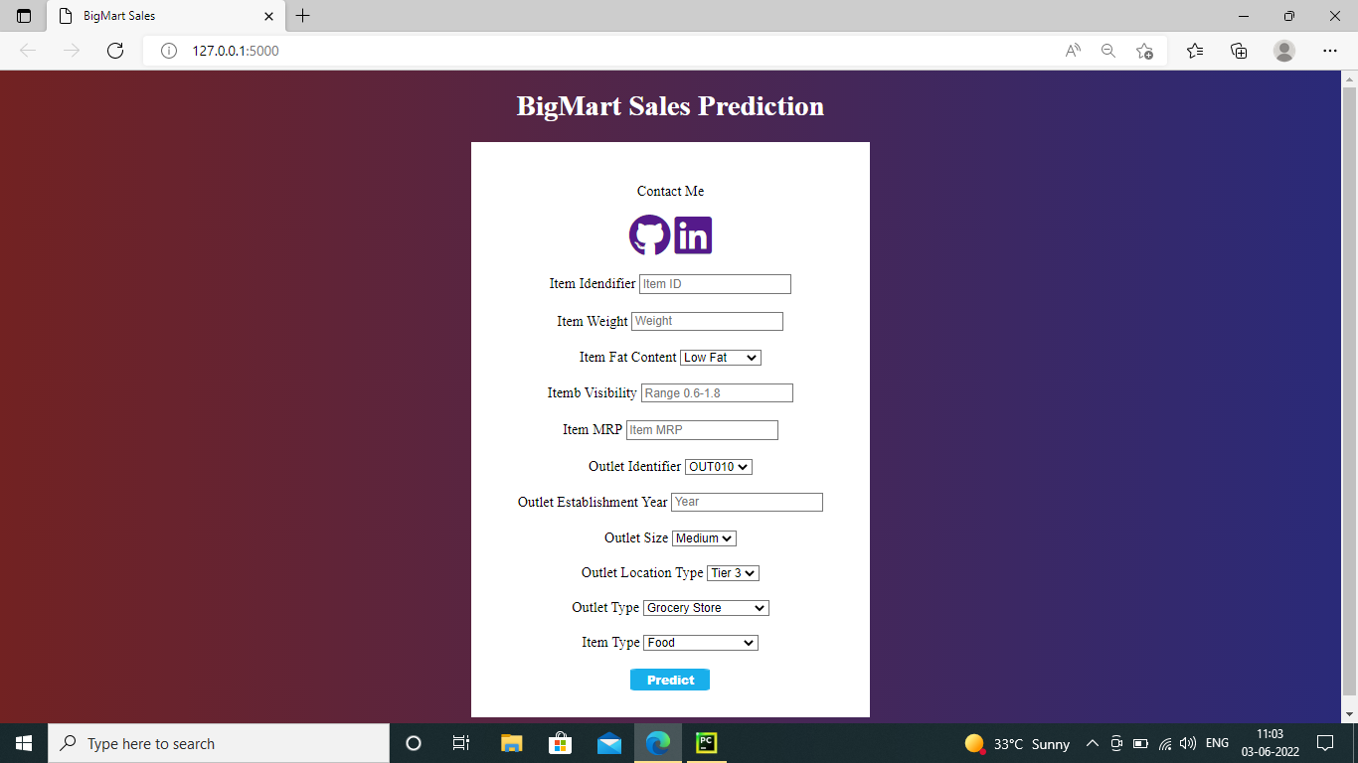
…Contd
Here are the screenshots of the user interface filling with the values.

Slide 24
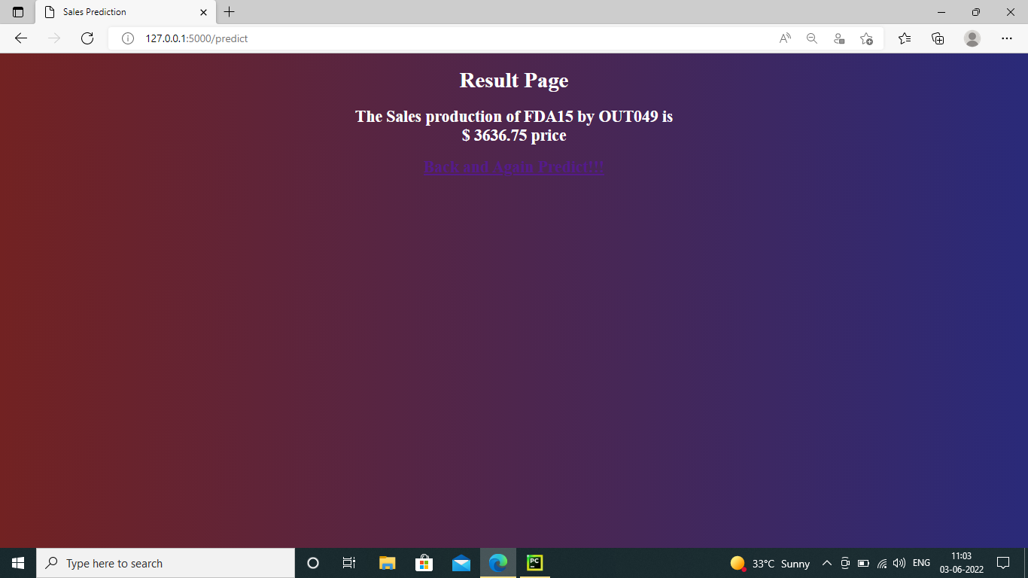
…Contd
Here is the screenshot where we get the sales production of the given Item_Identifier. It gives the value which is the future scope of a particular product in the means of highest value.

Slide 25
Conclusion
Prediction of sales is very much necessary for any kind of business irrespective of size of the business. Profit is very important for any business thus it is necessary to cut down the loss for any kind of business.
This can be made only we can predict the sales of next day or next month or next year.
By performing the analysis using all the four algorithms XG Boost regressor provided the high accuracy for the trained model and predicts the sales more accurately compared to the Linear, Random Forest, Ridge regression algorithms.
XG Boost regression provided the accuracy of the model with 86.25%.
By this we can conclude that the prediction of sales is made using Regression algorithms and among them XG Boost regression can predict more accurately compared to the other two algorithms.

Slide 26
Reference
[1] Nikita Malik,Karan Singh, “Big Mart Sales Prediction”, Maharaja Surajmal Institute Journal of Applied Reasearch, where the paper published, vol 3, Issue 1; January-June 2020.
[2] Heramb Kadam,Rahul Shevade,Deven Ketkar,Sufiyan Rajguru “A Forecast for Big Mart Sales Based on Random Forest and Multiple Linear Regression”, International Journal of Engineering Development and Research(IJEDR 2018),where the paper published,volume 6,Issue 4.
[3] Gopal Behara,Neeta Nain,”A Comparative study of Big mart sales prediction”Malaviya National Institute of Technology Jaipur,India.
[4]Dataset

Slide 27
Thank You!!!

